Slide 1
Joins for the coffee and coding club
Al Brodlie

Slide 2
Contents
What are joins
Excel equivalent
Hive-SQL (HES) equivalent
R syntax
Further joins – anti-join/semi-join

Slide 3
What are joins
Joins are needed when you want to join two tables together by a column they have in common.
In health an example of “the thing in common” is provider code/CCG code/region code
One example we often have is linking finance and activity to analyse productivity.

Slide 4
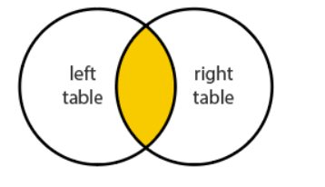
Inner Join
This is where we only keep records which have a code in both tables.
You will now have a new table with columns from each of the two original tables.

Slide 5
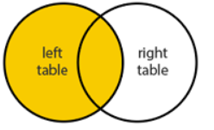
Left Join
This is where we only keep records which have a code in the left table.
If they don’t have an equivalent code in the right table this will return a blank in the columns associated with the right table .

Slide 6
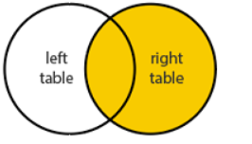
Right Join
The same as a left join, but includes all records from the right table and will only add records from a left table with a code the same as an element in the right table

Slide 7
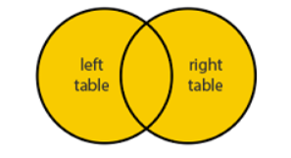
Outer Join
This includes all records even if they are just in one table and not the other. They will include blank elements for the table columns which could not find a join.
In R this called a full join

Slide 8
Excel
Vlookup and hlookup are usually used in Excel for joining two datasets
However, also sumifs/countifs/offsets/matches can do similar jobs.

Slide 9
Hive SQL (for HES)
The syntax here is
Select Spend , Operations, provider
From Finance inner join Activity on provider = provider
Group by provider

Slide 10
R syntax
Simplest case is where you join by one code (e.g. provider) and it is the same in both tables
inner_join(Finance, Activity, by = "Provider" )
full_join(Finance, Activity, by = "Provider" )
left_join(Finance, Activity, by = "Provider" )
right_join(Finance, Activity, by = "Provider" )
Note the underscore, and full rather than outer, quotes around the column name and the =.

Slide 11
R syntax
Next case is where you join by two code (e.g. providers and CCGs) and it is the same name in both tables
inner_join(Finance2, Activity2, by = c("Provider","CCG" ))
full_join(Finance2, Activity2, by = c("Provider","CCG" ) )
left_join(Finance2, Activity2, by = c("Provider","CCG" ) )
right_join(Finance2, Activity2, by = c("Provider","CCG" ))
Note the ,

Slide 12
R syntax
Next case is where you join by one code (e.g. providers or CCGs) but they have different names in the two tables
inner_join(Finance2, Activity2, by = c("Provider” = "Code" ))
full_join(Finance2, Activity2, by = c("Provider” = "Code" ))
left_join(Finance2, Activity2, by = c("Provider” = "Code" ))
right_join(Finance2, Activity2, by = c("Provider” = "Code" ))
Note the =

Slide 13
Semi Join
A semi join will take only return records which can be matched to the right table, but will only return the columns from the first table.
A bit like a right join but only returns from the left table.
The R syntax is
semi_join(Finance, Activity, by = "Provider")

Slide 14
Anti Join
This will only return values from the left table which don’t have a match in the right table.
In our example this would be useful for identifying the scale of activity under-reporting etc.
The R syntax is
anti_join(Finance, Activity, by = "Provider")

Slide 15
Base R equivalent
inner_join is from the dplyr library tidyverse
The base R equivalent is merge

